Slide 1

Workshop on Data Science in Africa
June 19, 2015
Reuben Cummings
Data Scientist, HDX Data Lab Nairobi
@reubano ◆ @humdata
Notes:
Hi I’m Reuben. Data Scientist at HDX.

Slide 2
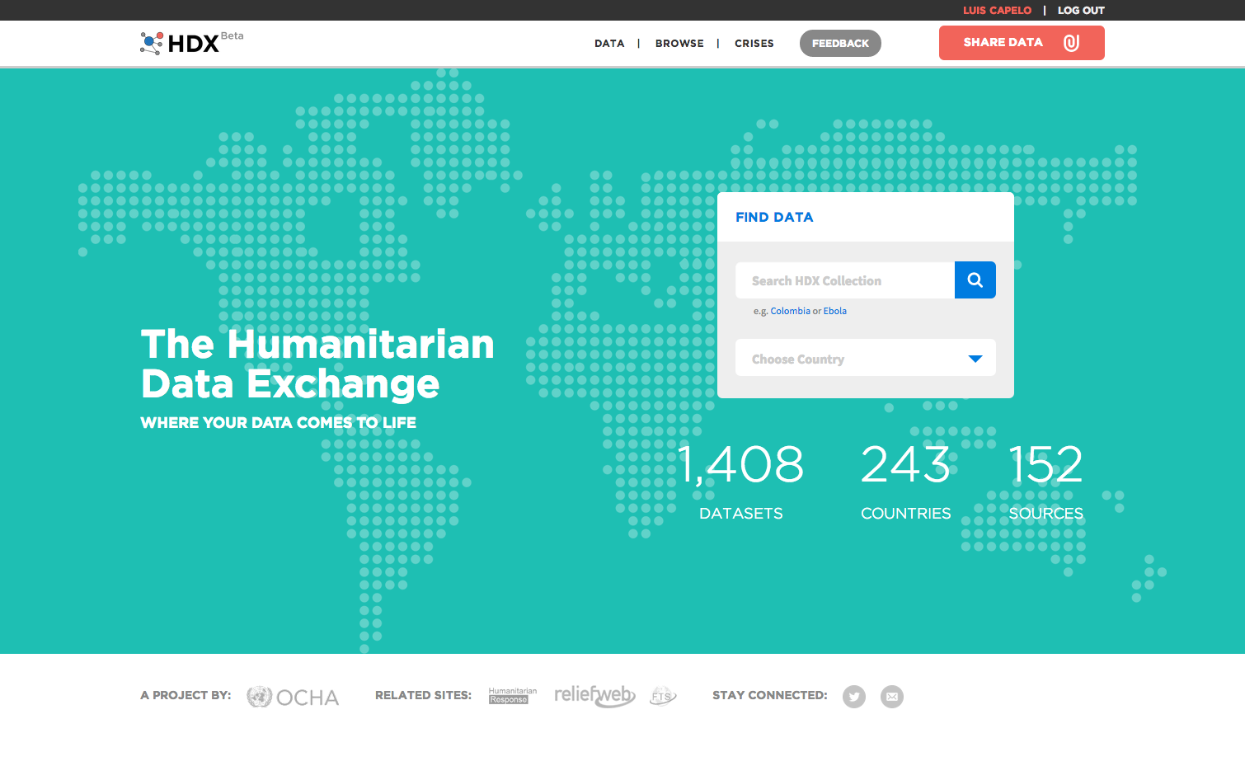
Notes:
So, what is HDX?
UN OCHA’s open platform for sharing humanitarian data.
Our objective is to make this data easily searchable and useable for analysis.
OCHA is the Office for the Coordination of Humanitarian Affairs.
It helps UN Member States prepare for crises via early warning information, vulnerability analysis, and capacity-building programs.
In short, OCHA mobilizes humanitarian assistance for all people in need.
Now, I’m going to take you on a tour of HDX’s core features and show you a few cool things you can do. You can start out by entering a search term in box you see on the right side of the screen.

Slide 3
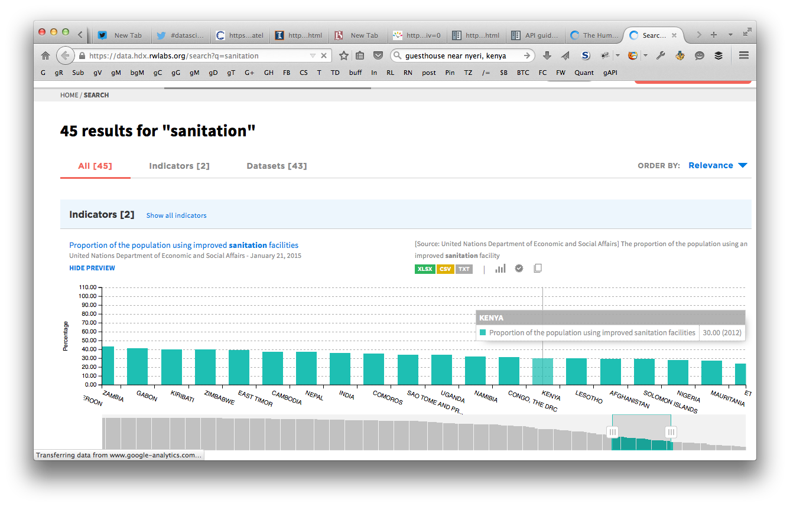
Search
@reubano ◆ @humdata
Notes:
After entering your search term, HDX shows you all relevant results, inclusing any available indicator visulizations. This search for sanitation, shows the % of each country’s population using improved sanitation facilities. Kenya is highlitghed and shows 30%.

Slide 4
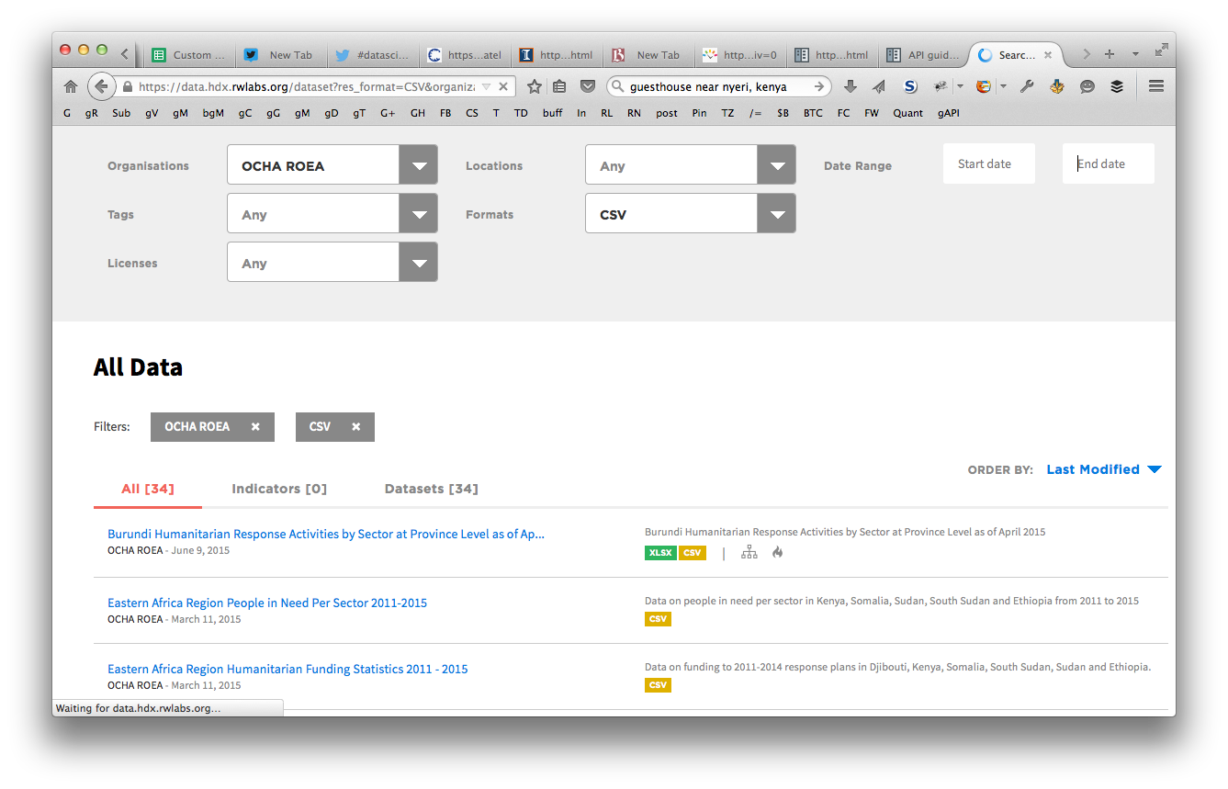
Filter
@reubano ◆ @humdata
Notes:
You’re able tto filter the search results by organization, tag, location, etc. Here, you can see that I’ve applied filters to only show me csv data sources upload by OCHA Regional Office for Eastern Africa (ROEA). You can also sort result by relevance, name, modification date, or popularity.

Slide 5
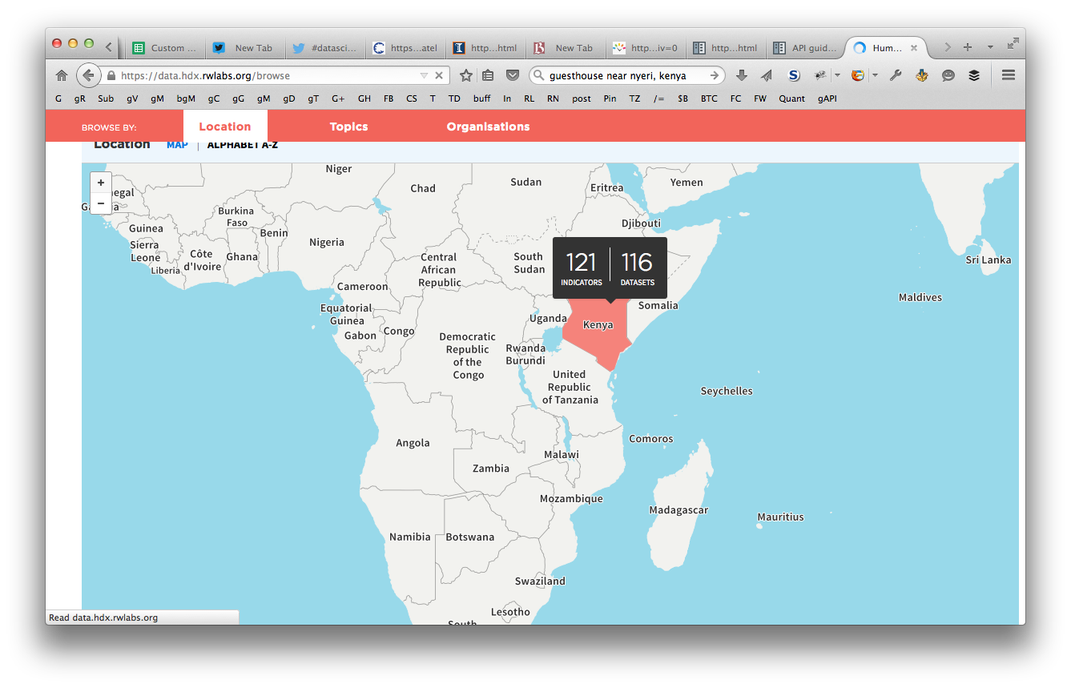
Browse
@reubano ◆ @humdata
Notes:
In addition to searching, you can also browse our collection by country, topic, and organization.
Here you see the location browser with Kenya highlighted.
Hovering over any of the coutries will reveal similar statistics on the number of indicators and datasets available for that country.

Slide 6
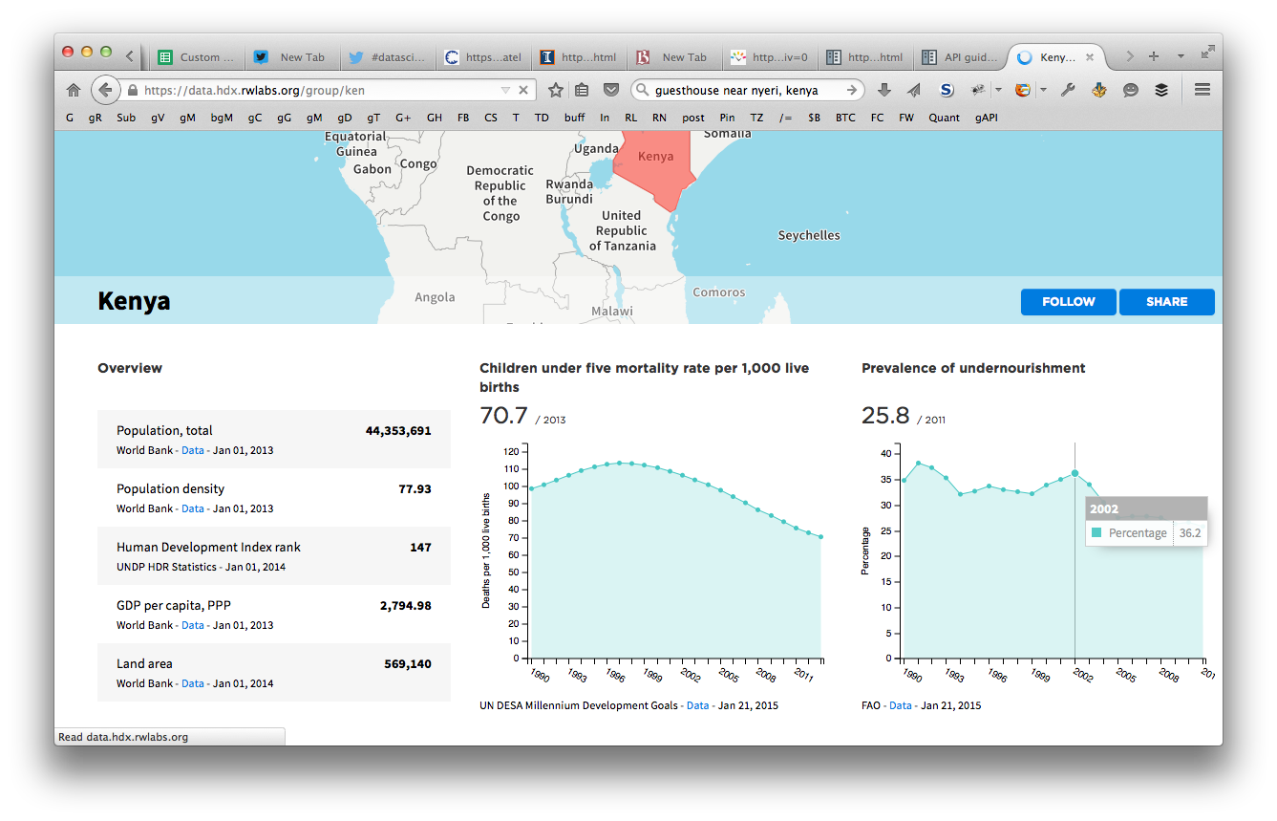
Browse
@reubano ◆ @humdata
Notes:
Once you click on a country, your taken to the country page with interactive visualization of any relevant indicators. Above, you can see the selected data point showing a 36% prevelance of malnourishment in Kenya in 2002.

Slide 7
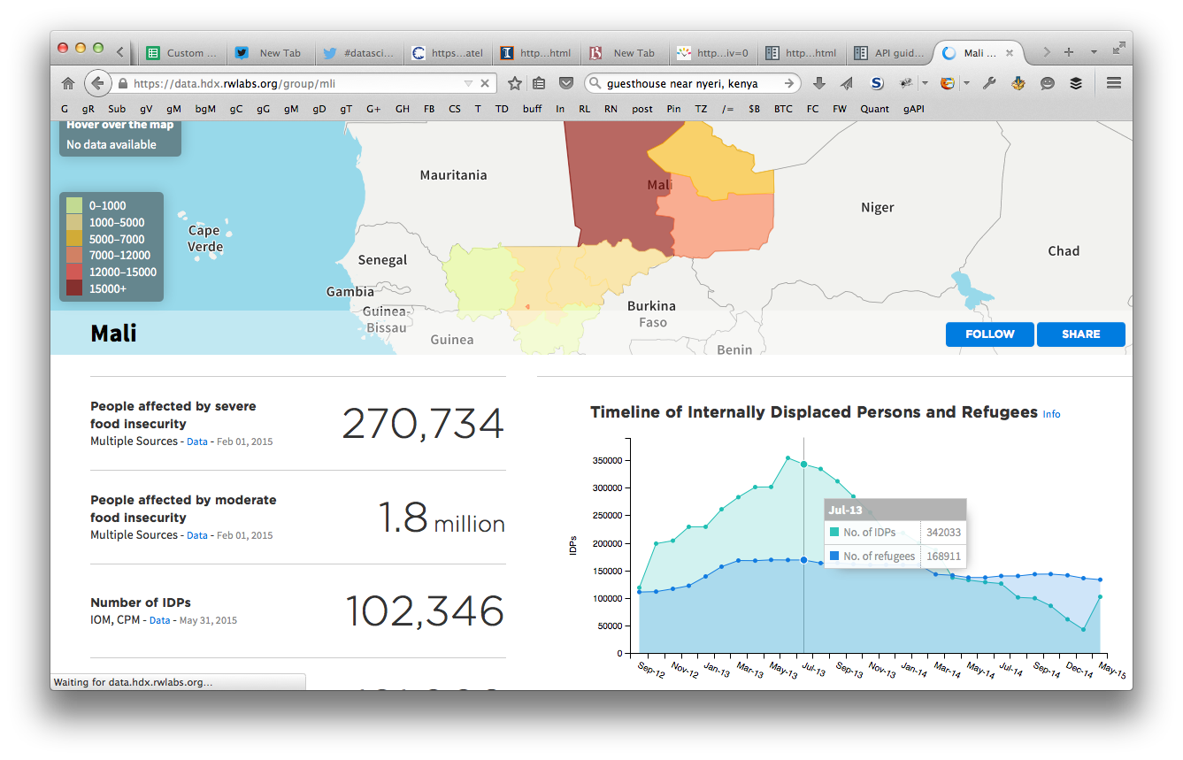
Customize (country)
@reubano ◆ @humdata
Notes:
Some country pages have a custom designed theme applied. This page for Mali was designed to highlight the number of internally displaced people.

Slide 8
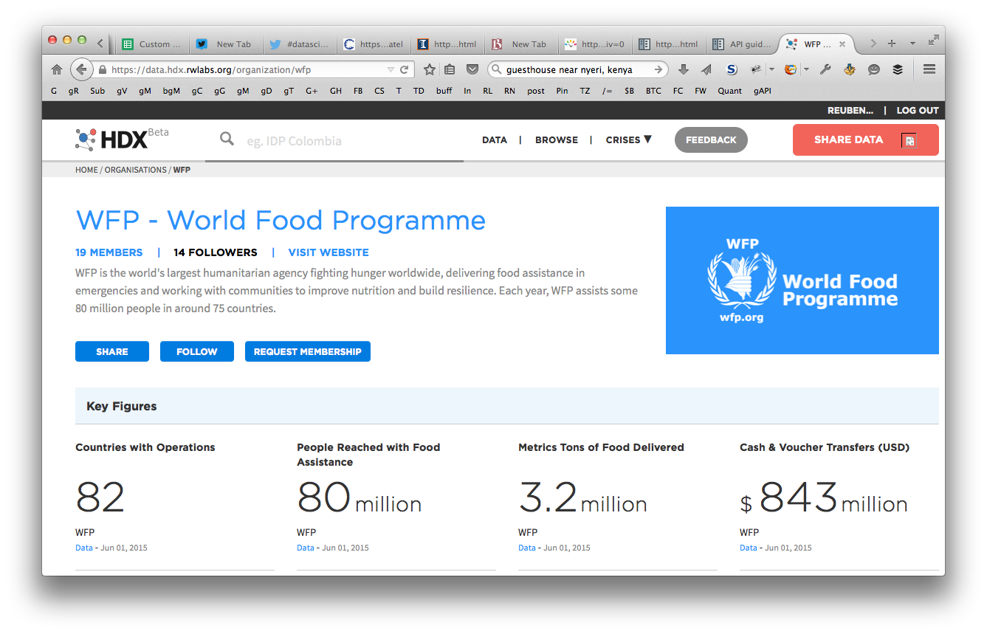
Customize (WFP)
@reubano ◆ @humdata
Notes:
Similarly, orginization pages can also be custom-designed. Here, you see a page made specifically for WFP to highlight the vast amount of food price and security information they have available.

Slide 9
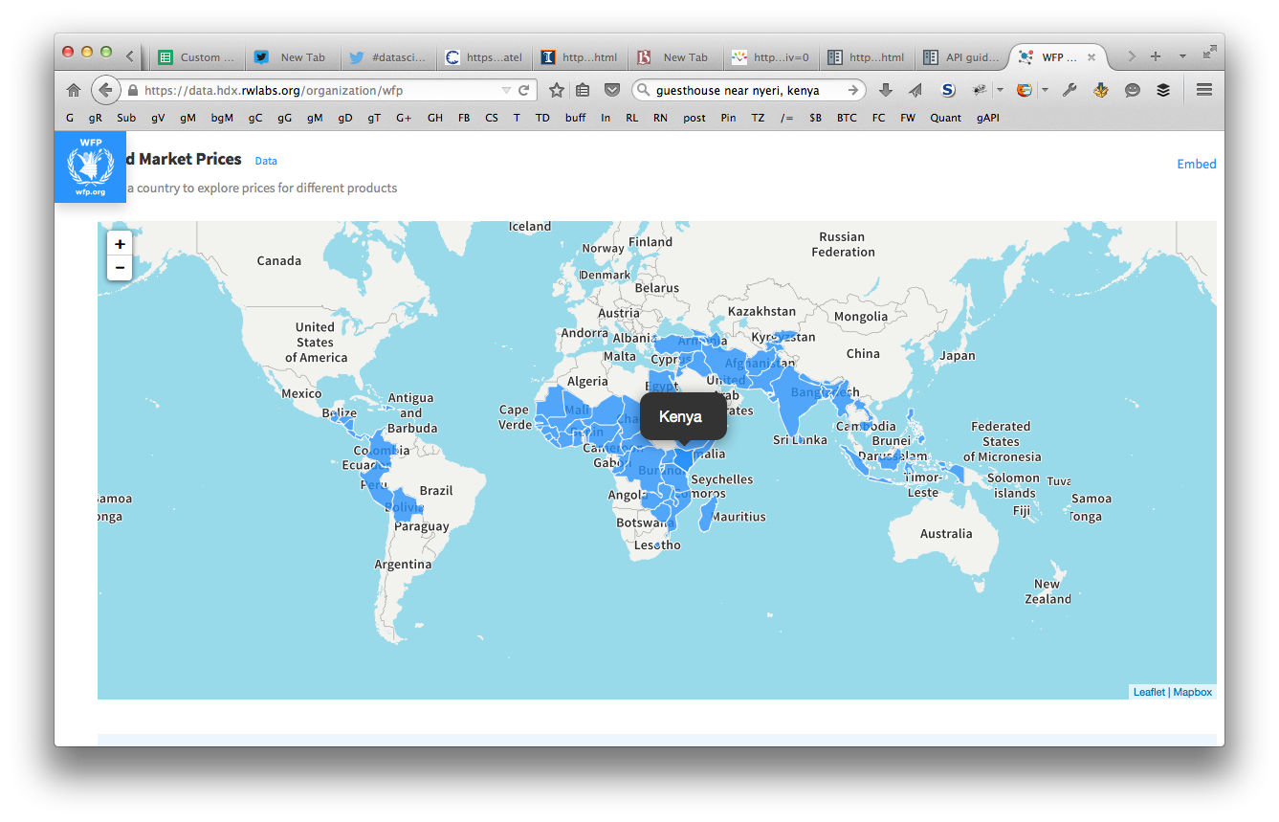
Customize (WFP)
@reubano ◆ @humdata
Notes:
For each country that WFP has information available, you can click it on the map to view the details.

Slide 10
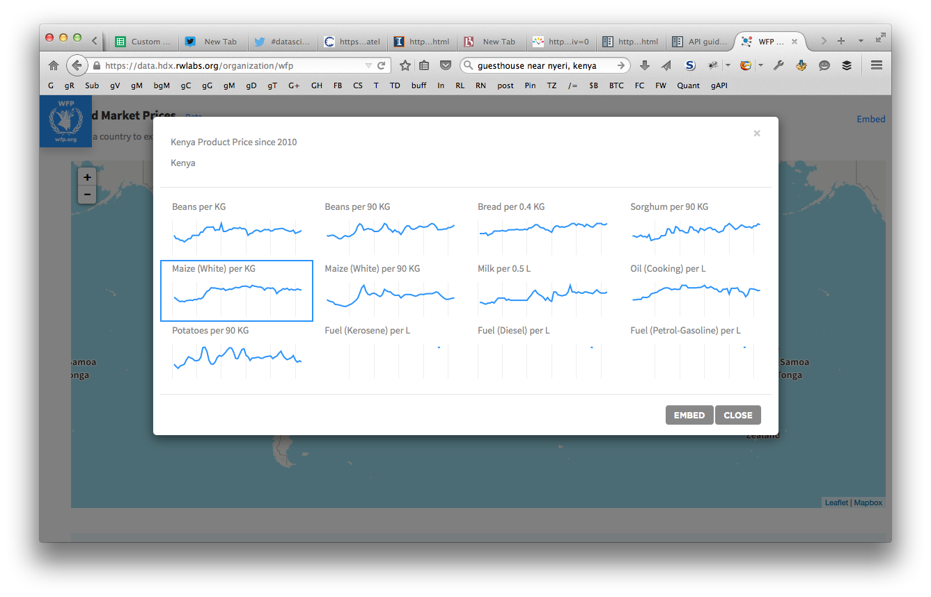
Customize (WFP)
@reubano ◆ @humdata
Notes:
Once clicked, a window pops up with all available food items.

Slide 11
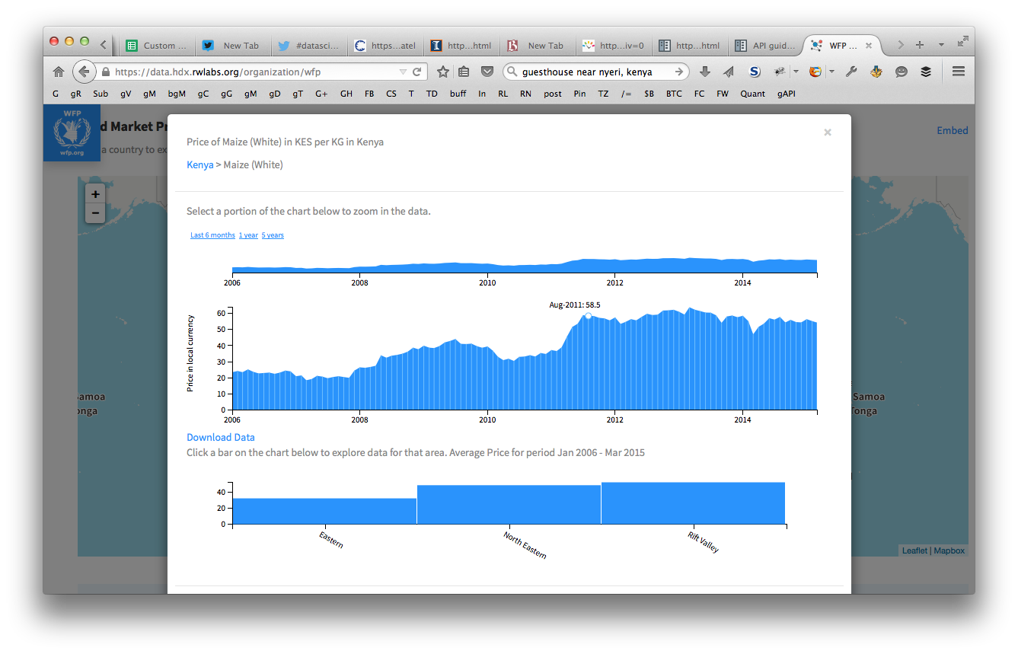
Customize (WFP)
@reubano ◆ @humdata
Notes:
Clicking on a particular food item shows you the pricing trends over time and optionally by region.

Slide 12
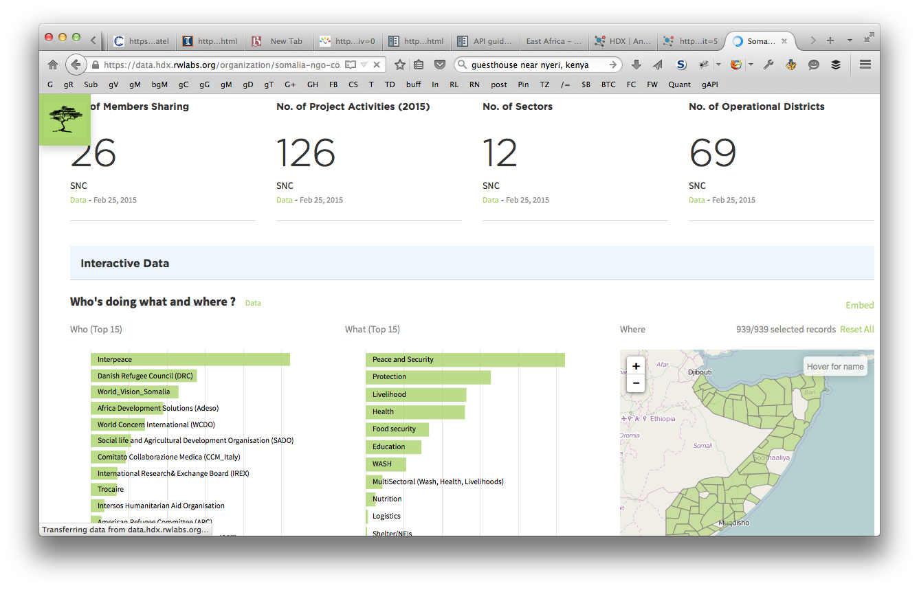
Customize (3W)
@reubano ◆ @humdata
Notes:
The other type of custom org page is know as 3W, which stands for Who’s doing what and where. This fully interactive visualization shows which implementation partners are doing specific programs and in which locations.

Slide 13
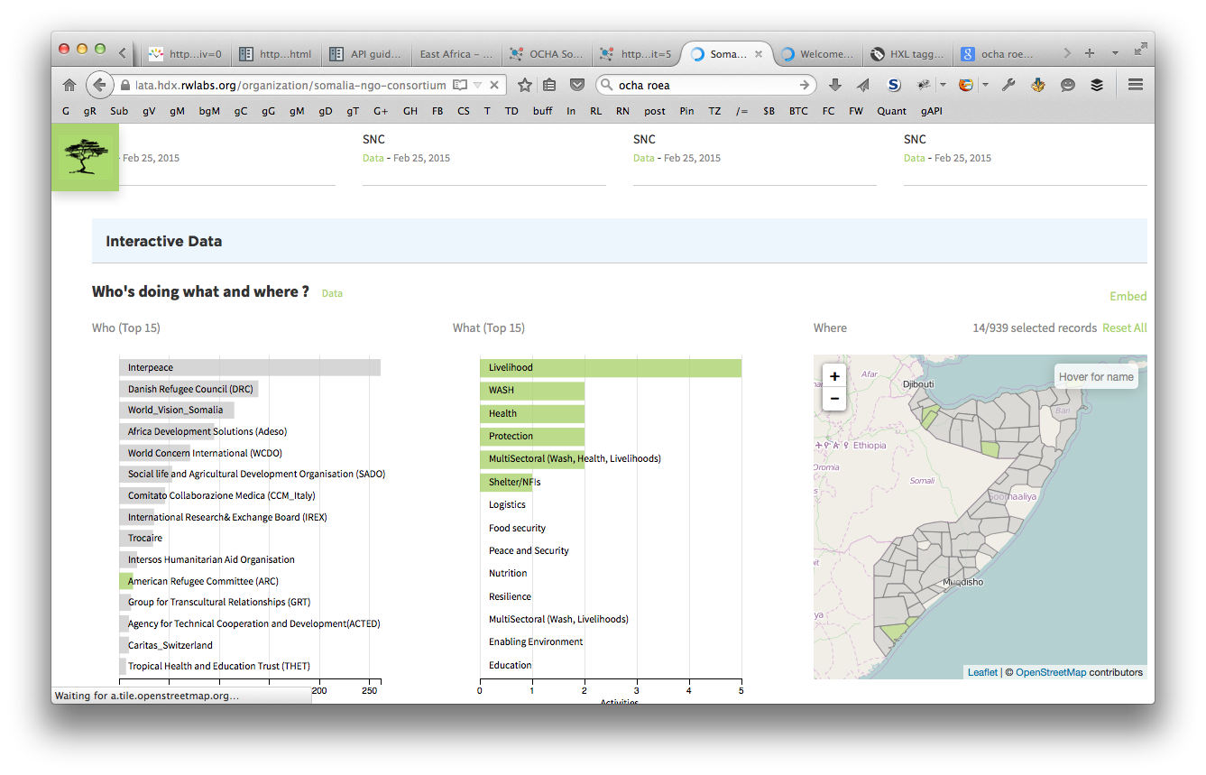
Customize (3W)
@reubano ◆ @humdata
Notes:
Here, you can see I’ve selected the ARC partner, and can easily see what activites they are participating in and which districts in Somalia they are present.

Slide 14
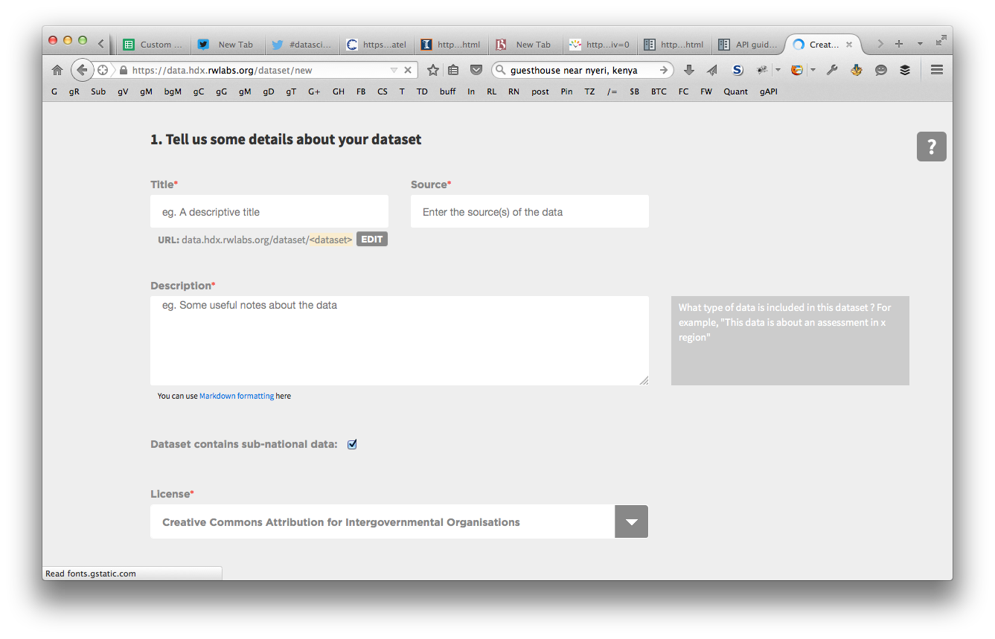
Share
@reubano ◆ @humdata
Notes:
Sharing data involves filing in some basic information about the data such as description, license, and data collection method.

Slide 15
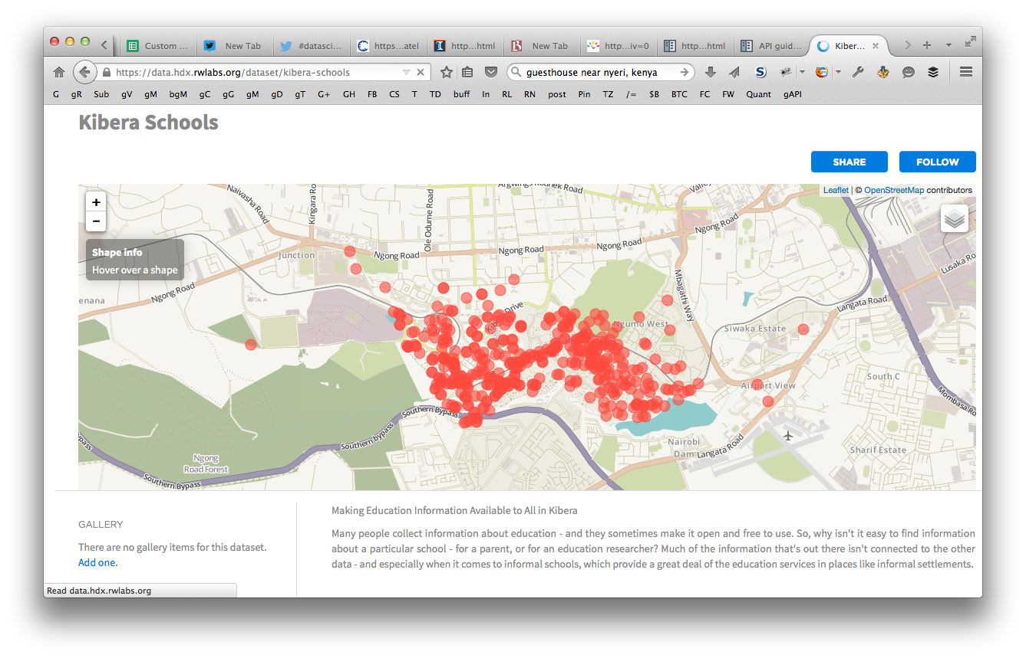
Geo-preview
@reubano ◆ @humdata
Notes:
HDX recognizes geojson data and automatically creates an interactive geo preview. This is a preview of geo coded schools in Kibera, Kenya.

Slide 16
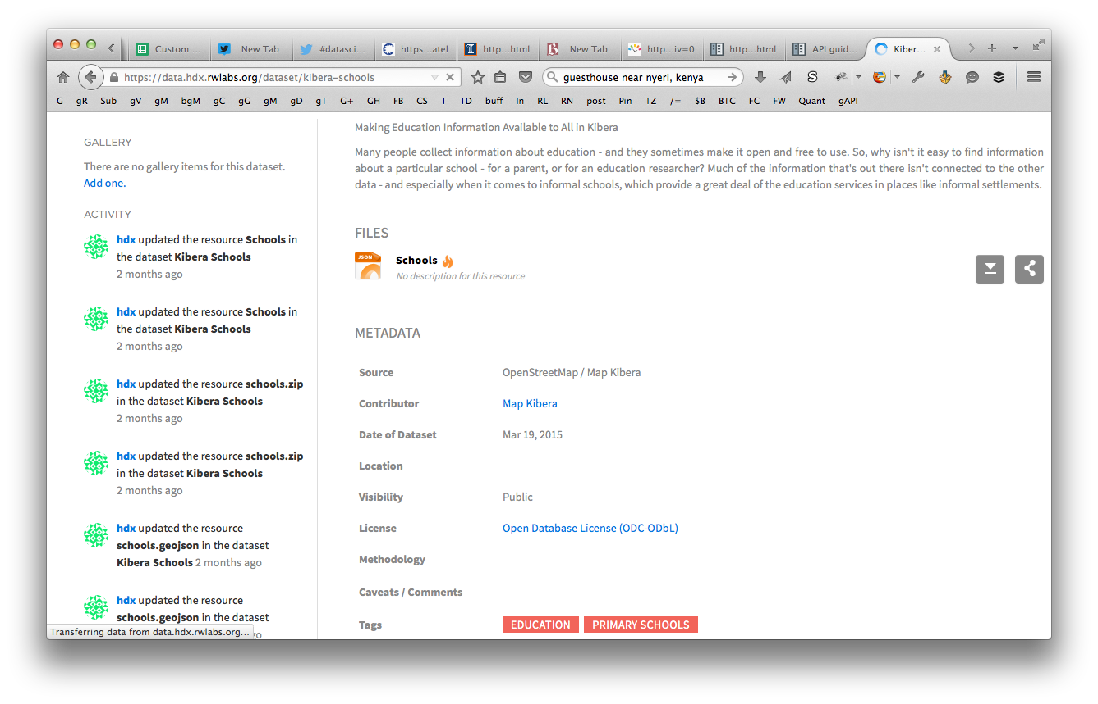
Metadata
@reubano ◆ @humdata
Notes:
Clicking on a datasets shows the associated resource files and complete metadata including data source, date, license, etc.

Slide 17
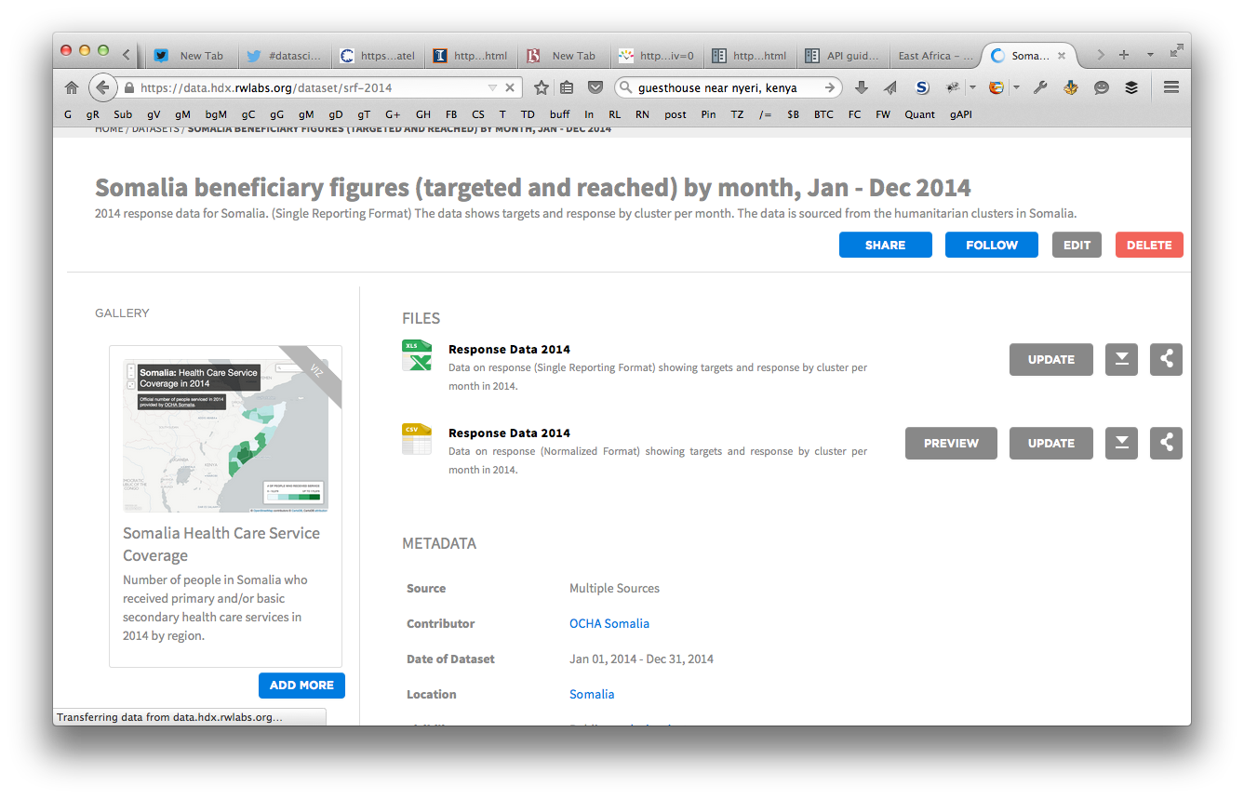
Visualize
@reubano ◆ @humdata
Notes:
If present, the dataset will also display any visualizations added to the gallery. To the left you can see a Carto DB viz I created showing the Health Care Service Coverage in Somalia.

Slide 18
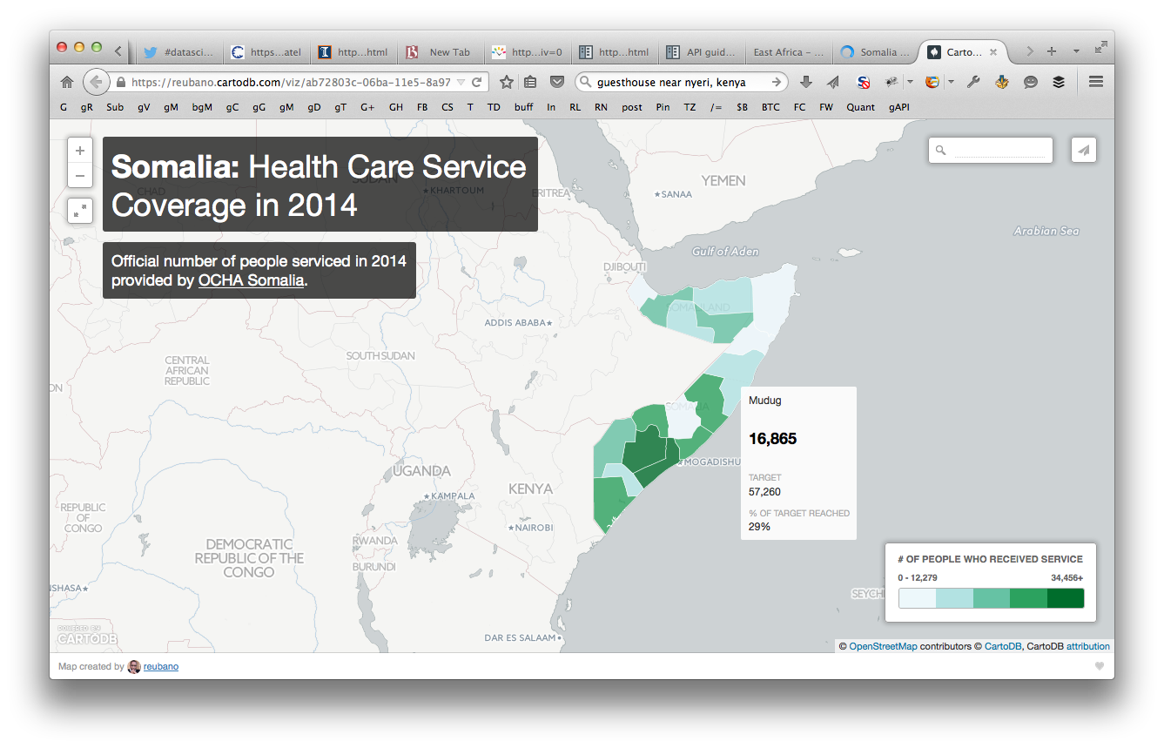
Visualize
@reubano ◆ @humdata
Notes:
Clicking on the gallery item takes you to the actual visualization.

Slide 19
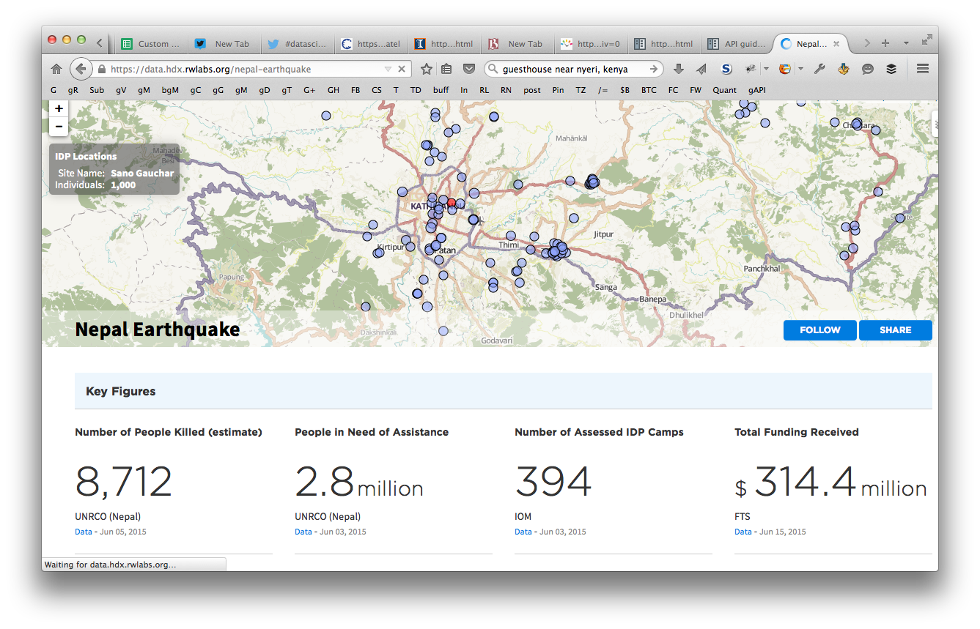
Monitor
@reubano ◆ @humdata
Notes:
- Another interesting use of the HDX Platform is crisis monitoring
- Through specially created event pages, you can monitor crises in real time, such as this page showing internally displaced people from the recent Nepal Earthquake.

Slide 20
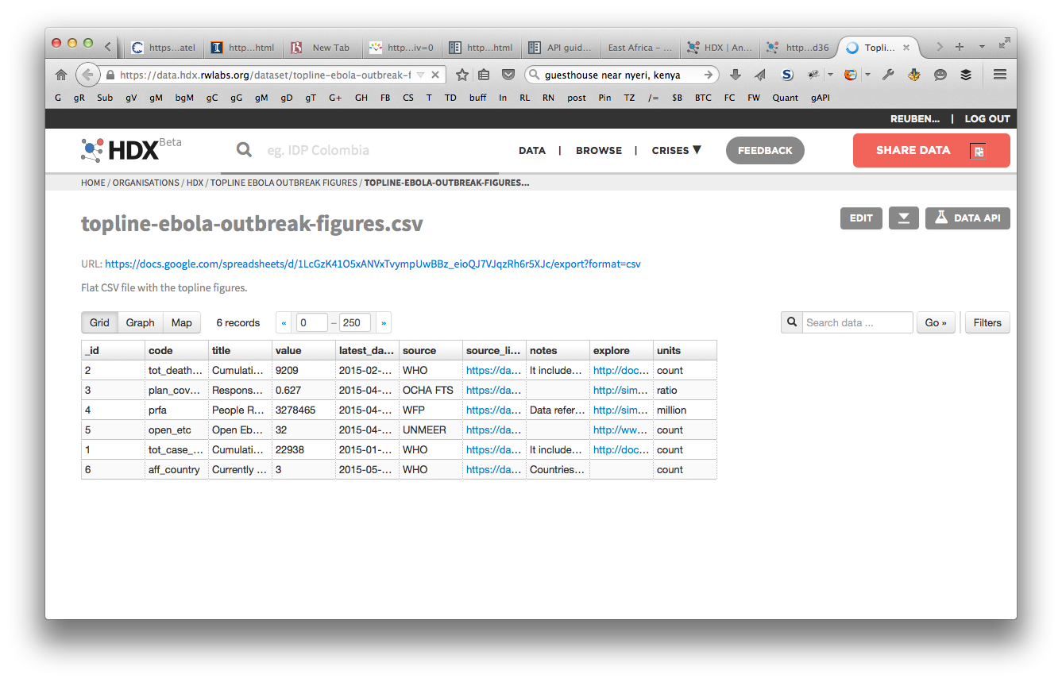
Consume
@reubano ◆ @humdata
Notes:
A subset of the resources have an api enabled which allow you programatically access the data. Just look for a Data API button as you can see circled on the right.
- Show preview button on slide #17

Slide 21
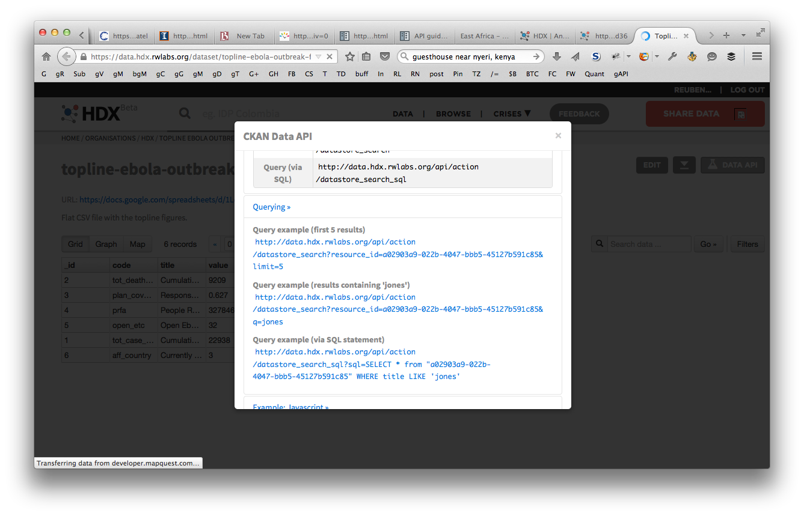
Consume
@reubano ◆ @humdata
Notes:
Clicking on that button shows you the different types of requests you can make to query and update data.

Slide 22
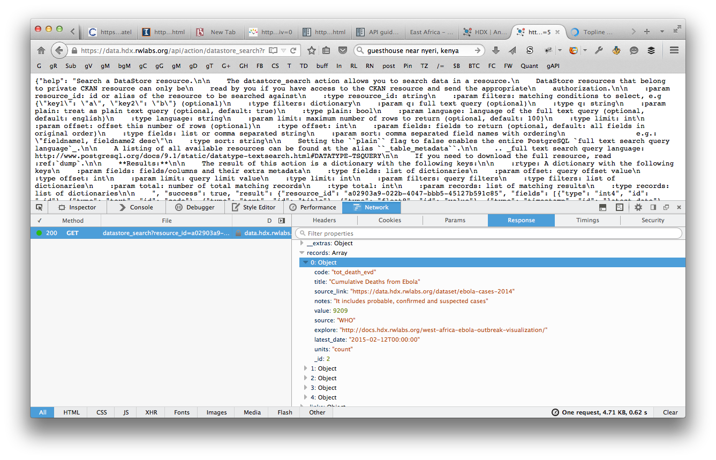
Consume
@reubano ◆ @humdata
Notes:
This is example of a get request returning a json representation of the table seen earlier.

Slide 23
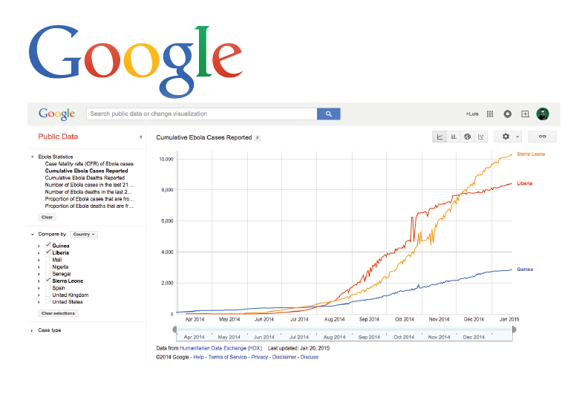
Consume
@reubano ◆ @humdata
Notes:
This open api allows 3rd parties such as Google and NYTimes to create visualizations of their own from data hosted on the HDX platform.

Slide 24
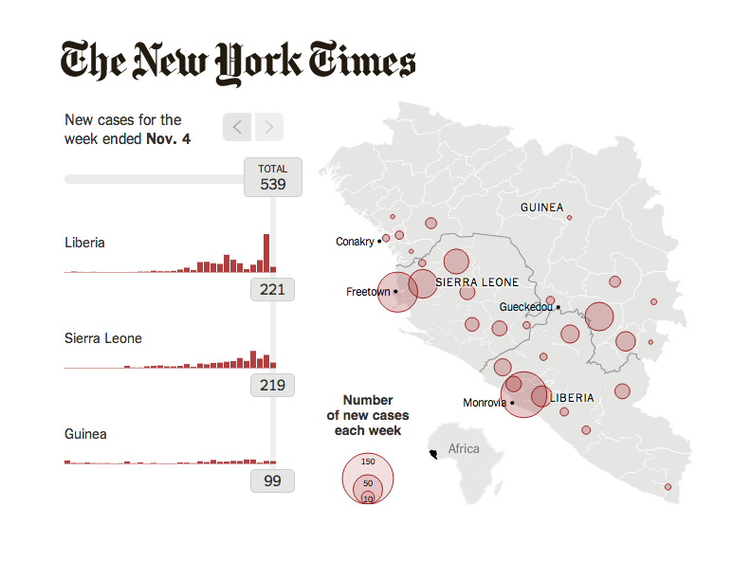
Consume
@reubano ◆ @humdata
Notes:
This open api allows 3rd parties such as Google and NYTimes to create visualizations of their own from data hosted on the HDX platform.

Slide 25
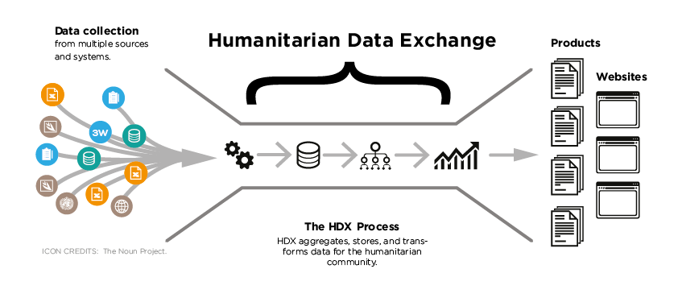
Curated Data
@reubano ◆ @humdata

Slide 26
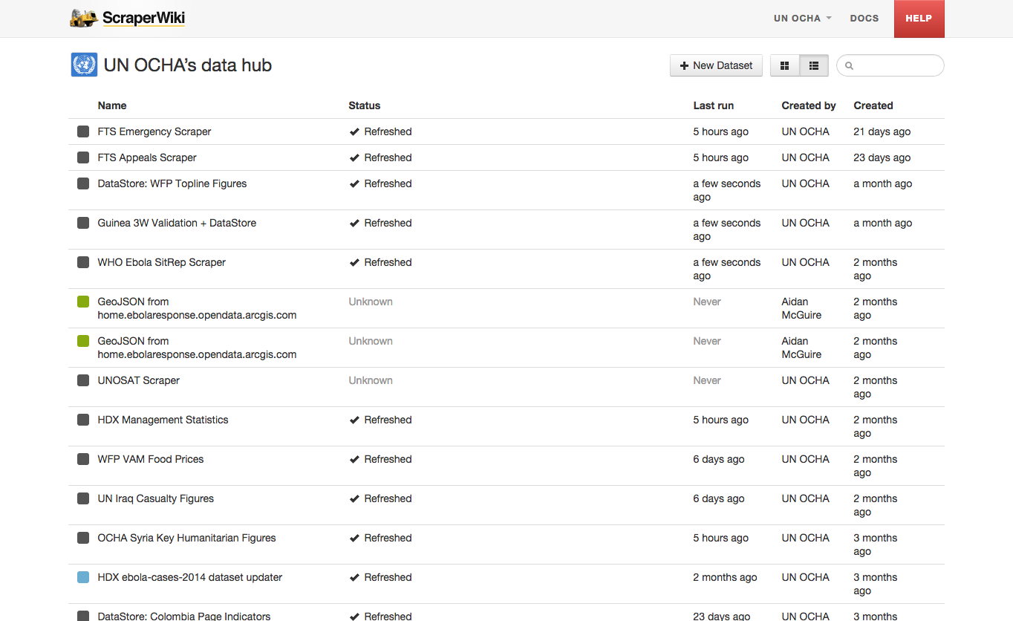
Curated Data
@reubano ◆ @humdata

Slide 27
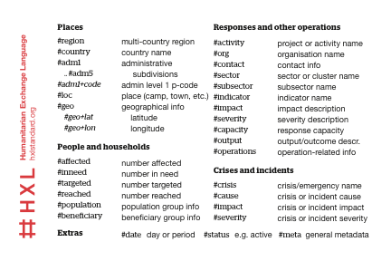
HXL
@reubano ◆ @humdata
Notes:
The last thing I’m going to mention to you is HXL
Humanitarian Exchange Language

Slide 28
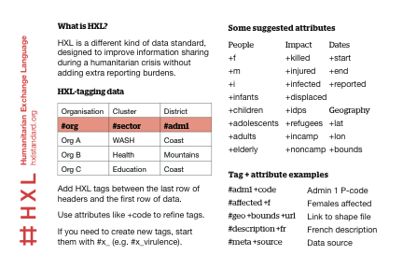
HXL
@reubano ◆ @humdata

Slide 29
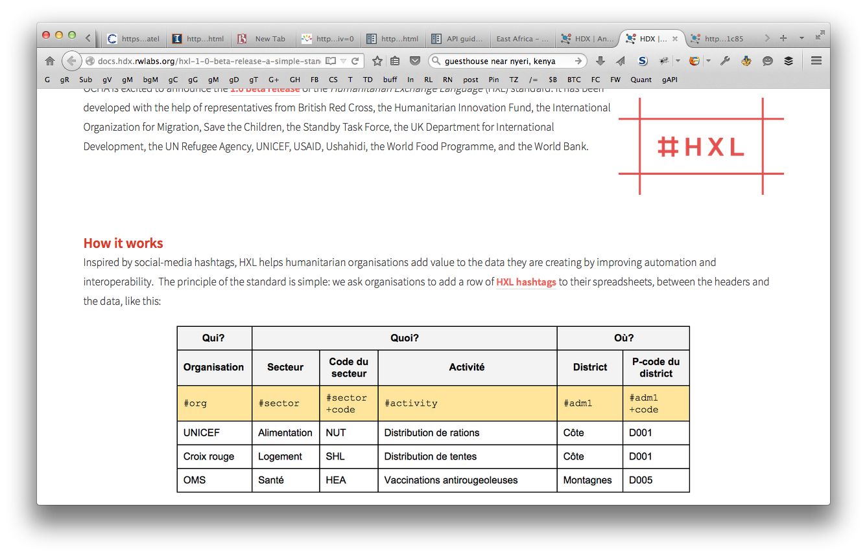
HXL
@reubano ◆ @humdata

Slide 30
Thank you!
@humdata
data.hdx.rwlabs.org
hdx@un.org
@reubano ◆ @humdata

Slide 31
Stats
1,865 Datasets
244 Locations
276 Sources
@reubano ◆ @humdata
Notes:
Some org pages are custom-designed.

Slide 32
Data Licenses
Creative Commons Attribution for Intergovernmental Organisations (CC BY-IGO)
Creative Commons Attribution (CC BY)
Creative Commons Attribution-ShareAlike (CC BY-SA)
@reubano ◆ @humdata
Notes:
Creative Commons Attribution for Intergovernmental Organisations (CC BY-IGO)
Creative Commons Attribution (CC BY)
Creative Commons Attribution-ShareAlike (CC BY-SA)
Open Database License (ODC-ODbL)
Open Data Commons Attribution License (ODC-BY)
Open Data Commons Public Domain Dedication and License (PDDL)
Public Domain/No restrictions (CC0)

Slide 33
Data Licenses
Open Database License (ODC-ODbL)
Open Data Commons Attribution License (ODC-BY)
Open Data Commons Public Domain Dedication and License (PDDL)
Public Domain/No restrictions (CC0)
@reubano ◆ @humdata
Notes:
Creative Commons Attribution for Intergovernmental Organisations (CC BY-IGO)
Creative Commons Attribution (CC BY)
Creative Commons Attribution-ShareAlike (CC BY-SA)
Open Database License (ODC-ODbL)
Open Data Commons Attribution License (ODC-BY)
Open Data Commons Public Domain Dedication and License (PDDL)
Public Domain/No restrictions (CC0)

Slide 34
Does HDX accept personally identifiable information?
No. HDX will not store personally identifiable information. All data shared through the platform must be sufficiently aggregated or anonymized so as to prevent identification of individuals or other harm to affected people and the humanitarian community.
@reubano ◆ @humdata
Notes:
Creative Commons Attribution for Intergovernmental Organisations (CC BY-IGO)
Creative Commons Attribution (CC BY)
Creative Commons Attribution-ShareAlike (CC BY-SA)
Open Database License (ODC-ODbL)
Open Data Commons Attribution License (ODC-BY)
Open Data Commons Public Domain Dedication and License (PDDL)
Public Domain/No restrictions (CC0)

